Slide 1
Prediction of MiRNA sequence using CNN and LSTM
TEAM MEMBERS:
ABINUS MERCY A -2019103501
KANISHKAA R - 2019103534
KAVISHREE S -2019103537

Slide 2
Project analysis slide 2
Content
1
INTRODUCTION
2
LITERATURE SURVEY
3
PROBLEM STATEMENT
4
OBJECTIVE
5
SYSTEM ARCHITECTURE
6
LIST OF MODULES
7
IMPLEMENTATION
8
EVALUATION METRICS
9
REFERENCES

Slide 3
Project analysis slide 2
Introduction
Micro(mi)RNAs are small noncoding RNAs that regulate expression of the majority of the genes in the genome at either the messenger RNA (mRNA) level (by degrading mRNA) or the protein level (by blocking translation). miRNAs are thought to be components of vast regulatory networks. microRNA post-transcriptionally regulate gene expression by base-pairing to mRNAs. Currently, the field is focused primarily on identifying novel targets of individual miRNAs. Deep neural networks are machine learning algorithms which are inspired by biological neural networks. Neural networks require features as input and providing meaningful features, or feature selection is a tedious task. . For ease of integration with ANNs, CNNs are preferred over other techniques. For sequence to sequence prediction LSTM is more suitable.

Slide 4
Project analysis slide 4
Literature Survey
SNO | TITLE, AUTHOR, YEAR | METHODLOGY | ADVANTAGES | LIMITATIONS
1 | Prediction of miRNA targets by learning from interaction sequences by Xueming Zheng, Long Chen, Xiuming Li in 2020. | Multilayer convolutional neural network | Automatically extract patterns from canonical and non-canonical pairing between the miRNAs and its targets. | The complicated molecular interaction networks in the cell affects the interactions of miRNAs and target mRNAs
2 | miTarDigger: A Fusion Deep-learning Approach for predicting Human miRNA by Jianrong Yan, Yanan Li, Min Zhu in 2020. | The SDA (Stacked Denoising Autoencoder) and CAE (Convolutional Denoising Autoencoder) are used to pre-train in first step by original sequence and structured data respectively. The encoders of the two models are fused for prediction model | The added upstream and downstream sequence information improves the prediction accuracy of the model. The two-dimensional convolution is more effective for feature extraction of structure data. | High sensitivity, since autoencoders can be more sensitive to input errors than manual approaches. Misunderstanding important variables, Imperfect decoding, Training the wrong use case.

Slide 5
Project analysis slide 4
Literature Survey
SNO | TITLE, AUTHOR, YEAR | METHODLOGY | ADVANTAGES | LIMITATIONS
3 | Combining Supervised and Unsupervised Learning for Improved miRNA Target by Nafiesh Sedaghat, Mahmood Fathy, Mohammad Hossein Modarressi in 2018. | Unary and Binary SVM classifiers with Radial Basis Function (RBF) kernel. Three versions of each SVM classifier were used to identify miRNA-mRNA interactions by considering 1) only binding features 2) only network features 3) both set of features. | Binary SVM, the training data comprised both positive and negative examples. | It doesn’t perform well when large data set is used because required training time is higher.
4 | A Distributed classifier for microRNA target prediction with validation through TCGA expression data by Asish Ghosal, Jinyi Zhang in 2018. | SVM based model for miRNA target prediction using recent CLIP-seq data. | More productive in high dimensional places. SVM solves higher computational burden. | Not suitable for larger datasets.

Slide 6
SUMMARY
Multilayer Convolutional neural network gives better accuracy but due to complicated molecular interaction network of the cells affects the prediction of miRNA target. The SDA (Stacked Denoising Autoencoder) and CAE (Convolutional Denoising Autoencoder) methods are more effective for feature extraction of structure data. They are high sensitive ,hence autoencoders can be more sensitive to input errors than manual approach. Which results in training wrong use cases. SVM model doesn’t perform well when large data set is used because it requires higher training time.

Slide 7
SNO | TITLE, AUTHOR, YEAR | METHODLOGY | ADVANTAGES | LIMITATIONS
5 | Approaching miRNA family classification through constructive neural networks by Vinani A.Kashara, Maria C in 2018. | Two class and multiclass CoNN algorithm | Achieve results with the advantage of low computational cost and no model selection. | Maybe be leads to overfitting.
6 | Prediction of MicroRNA Subcellular Localization by Using a Sequence-to-Sequence Model by Yiqun Xiao, Jiaxun Cai, Yang Yang in 2018. | A sequence-to-sequence model to encode MiRNA sequences and predict their subcellular locations. Encoder-Decoder model Encoder part-BiLSTM. | Model learns high level features hidden in the MiRNA sequences. Encoder helps in mapping the input sequence into hidden states that lie in a low dimensional vector space. Decoder helps to determine the output of the next location. | Fails in capturing long distance dependencies in sequences.

Slide 8
SNO | TITLE, AUTHOR, YEAR | METHODLOGY | ADVANTAGES | LIMITATIONS
7 | Increasing the Target Prediction Accuracy of MicroRNA Based on Combination of Prediction Algorithms by Mohammed Q. Shatwani in 2016 | Data mining techniques were used to classify a number of characteristics involved in miRNA binding. Machine Learning Algorithm: SVM Naïve Bayes Decision Tree Learning Adaptive Boosting (Adaboost) algorithm to create the ensemble classifiers that consist of several SVM classifiers to improve performance. | Decreases false predictions using classifiers. Usage of many classifiers helps in better prediction. | This methodology does incur a cost as it is computationally heavy, with each other classifier have to be executed before the final result.
8 | Support Vector Machines for predicting MicroRNA hairpins by Karol Szafranski, Molly Megraw, Martin Reckzo and Artemis G.Hatzigeorgiou in 2015. | Machine Learning Algorithm: SVM | Better accuracy in results. Faster prediction. | not suitable for large datasets. SVM will underperform when the number of features for each datapoint exceeds the number of training data samples.

Slide 9
SUMMARY
Multiclass constructive neural network leads to overfitting. Sequence to Sequence encoding miRNA sequence fails in capturing long distance dependencies in sequences. Using only convolutional neural network leads to overlaps because the features they are derived from similar characteristics that consist of conservation, complementation and accessibility. Though Convolutional neural network extract multiple features at each location.

Slide 10
SNO | TITLE, AUTHOR, YEAR | METHODLOGY | ADVANTAGES | LIMITATIONS
9 | MiRTDL: A Deep Learning Approach for miRNA Target Prediction by Shuang Cheng, Maozu Guo, Chunyu Wang in 2015. | Computing the feature score. Constructing balanced datasets using constraint relaxation method. Training the classifier using CNN. | Multiple features can be extracted at each location using CNN. CNN avoids the effect of incorrect domain model on prediction. | The algorithm’s predictions have overlaps because the features they are derived from similar characteristics that consist of conservation, complementation and accessibility.
SUMMARY:
Though many machine learning algorithms are used in predicting miRNA sequence such as linear regression, decision tree, naive bayes, constructive neural network, SVM classifier results in better accuracy but fails when the dataset is too large to train and lead to overfitting. Since identifying patterns and features for binding mRNA and its complimentary miRNA is very tedious job at human level, we utilized CNN.RNNs with LSTM cells have proven applications in speech processing and natural language processing. Therefore, we included it to process the genetic language in case of RNAs.

Slide 11
Problem Statement
Prediction of microRNA targets, which has been a mind storming challenge for scientific community for decades, is a basic fundamental step in finding microRNA-mRNA target association.
The current methods for microRNA target predictions incorporate various computational methodologies, from the demonstration of physical association algorithms to the application of machine learning algorithms .
Most of these algorithms uses artificially negative set data for training, as experimentally validated negative set is very tedious to found, so these algorithms show low sensitivity in real data.
Because of not fully understood rules that govern miRNAs targeting process and different training datasets for different algorithms, there is limited overlap between the targets that are predicted by various programs.
So, it is still a challenge to develop more reliable computation methods based on more accurate miRNA.

Slide 12
Objective
Sequence level interaction is basic criteria for mRNA and miRNA interaction, so the crust of these interactions can be found in sequence level features which are hard to generate.
So, we propose Seq2Seq architecture which is proven to use in sequence level NLP data.
In the present work, we have used CNN to extract sequence features from input mRNA segment and fed these features to a LSTM system stacked in a sequence to sequence architecture.
This architecture generally consists of two LSTMs known as encoder and decoder.
Our method can predict miRNA sequences based on target mRNA segment where they bound.
The model can also predict some novel miRNAs which are not yet annotated.

Slide 13
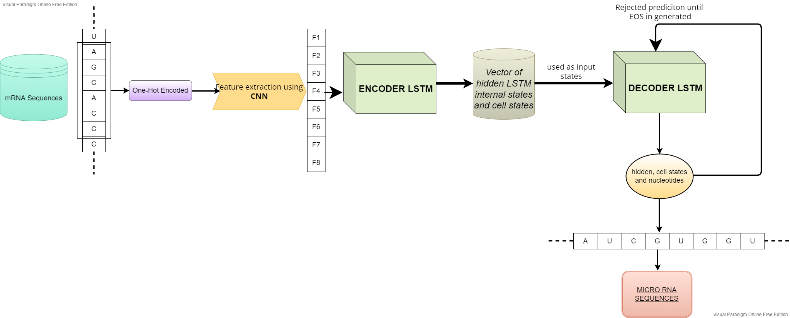
Project analysis slide 7
System architecture

Slide 14
Project analysis slide 8
List of Modules
1.Data Curation
2.Data Preprocessing and Preparing
3.Building Model
4.Training of the model
5.Predicting MiRNA sequence
6.Obtaining Surface Area Accessibility Regions as Target Binding Site of microRNA in 3’UTR of mRNAs
7.Developing final package

Slide 15
Project analysis slide 8
Module 01
DATA CURATION:-
For seq2seq architecture, sequence of microRNAs and their corresponding binding target sites in mRNA are required.
microRNA sequence were retrieved from miRBase release 22,March 2020.
The CSV file contains microRNA Name, Gene Symbol, Chromosome location of the target binding site according to Ensemble Human (GRCh38. p12) annotation

Slide 16
Project analysis slide 8
Module 02
In the dataset we analyzed that the difference between the lengths of pairs of microRNA and mRNA varied from 0 to 18.
To bring a uniformity in different in length of sequence so that our model may extract features based on patterns in the sequence not from the length of sequences, we looked into the distribution of the pair sequence length difference.
We found that the distribution was skewed, having around 90 percent of the difference in length pair of sequences between 0 to 6 .
So a threshold of 6 was set, and the microRNA and mRNA sequences having sequence length difference of 6 or less were used for further analysis.
DATA PREPROCESSING AND PREPARATION:-

Slide 17
Project analysis slide 8
Module 02
Categorical features such as mRNA and microRNA nucleotides first need to be encoded numerically. They are typically represented as binary vectors with all but one entry set to zero, which indicates the category (one-hot coded embedding).
One-hot coded strings which are input of a deep neural network model should be of same length, i.e., all microRNAs should be of same length, and all mRNA-target site sequence should be of same length, which is not the scenario of real world.
So, we took the largest sequence among the microRNA sequences as a default length of all microRNAs which turned out to be 28.
We made other short length microRNAs of same length by padding them with zeros. In the same way, we treated the mRNA sequences, and their default length turned out to be 29

Slide 18
Project analysis slide 8
Module 03
BUILDING MODEL:-
We are going to use Python programming language.
In Python, we are planning to use Keras library of deep learning using Tensorflow in background for building and training our model.
As mentioned in our architecture diagram, CNN is used to extract features from both mRNA and miRNA sequences.
LSTMs are stacked in sequence-to-sequence architecture were two LSTMs are used, one is encoder which processes the input sequence i.e., mRNA sequence features and the other, decoder, which predicts miRNA sequence using output states of encoder and output of CNN feature extracted from miRNA sequence one step at a time

Slide 19
Project analysis slide 8
Module 04
The most crucial task in this module is to determine the optimal number of neurons in each hidden layer for neural networks.
Less number of neurons make a network simple but may be less informative.
On the other hand, more number of neurons is good for complex data but may lead to slower learning during training, overfitting of the model etc.
We are trying to solve this issue using Adam optimizer for adjusting the weight of the neurons.
TRAINING OF THE MODEL:-

Slide 20
Project analysis slide 8
Module 05
The model used above for training will acquire weights according to the training set, but the architecture of this model will not be suitable for predicting output characters recursively one by one in every time step.
So another model had to be developed for the generation of miRNA sequence.
As mentioned in architecture diagram, we are going to develop a model for encoding sequences as input of characters and then taking the sequence of miRNA characters generated in every time step and using them as input and predicting the next character of the miRNA sequence.
PREDICITNG miRNA SEQUENCES:-

Slide 21
Project analysis slide 8
Module 06
OBTAINING SURFACE AREA ACCESSIBILITY REGIONS AS TARGET BINDING
SITE OF MICRORNA IN 3’UTR OF MRNAS:-
In this module, we need to retrieve sequences of all protein-coding transcripts of a query gene and their 3’UTRs(3' untranslated regions (3' UTRs) of messenger RNAs (mRNAs) ).
We are planning to use Ensembl REST API to get those information.
As Ensembl REST API will accept only transcript IDs as input, so a local SQLite database should be developed for mapping Gene Symbols with all respective protein-coding Ensembl transcript IDs.

Slide 22
Project analysis slide 8
Module 07
This module is about the output of our project.
While running the program, the user will be prompted to enter a Gene symbol.
Then the Gene symbol will be used to retrieve all associated protein-coding Ensembl transcript IDs.
We are still trying to find the algorithm suitable for mapping the predicted miRNA sequence to miRNA IDs.
After the completion of the project, we will be able to retrieve a list of predicted miRNA for a Gene symbol.
DEVELOPING FINAL PACKAGE:-

Slide 23
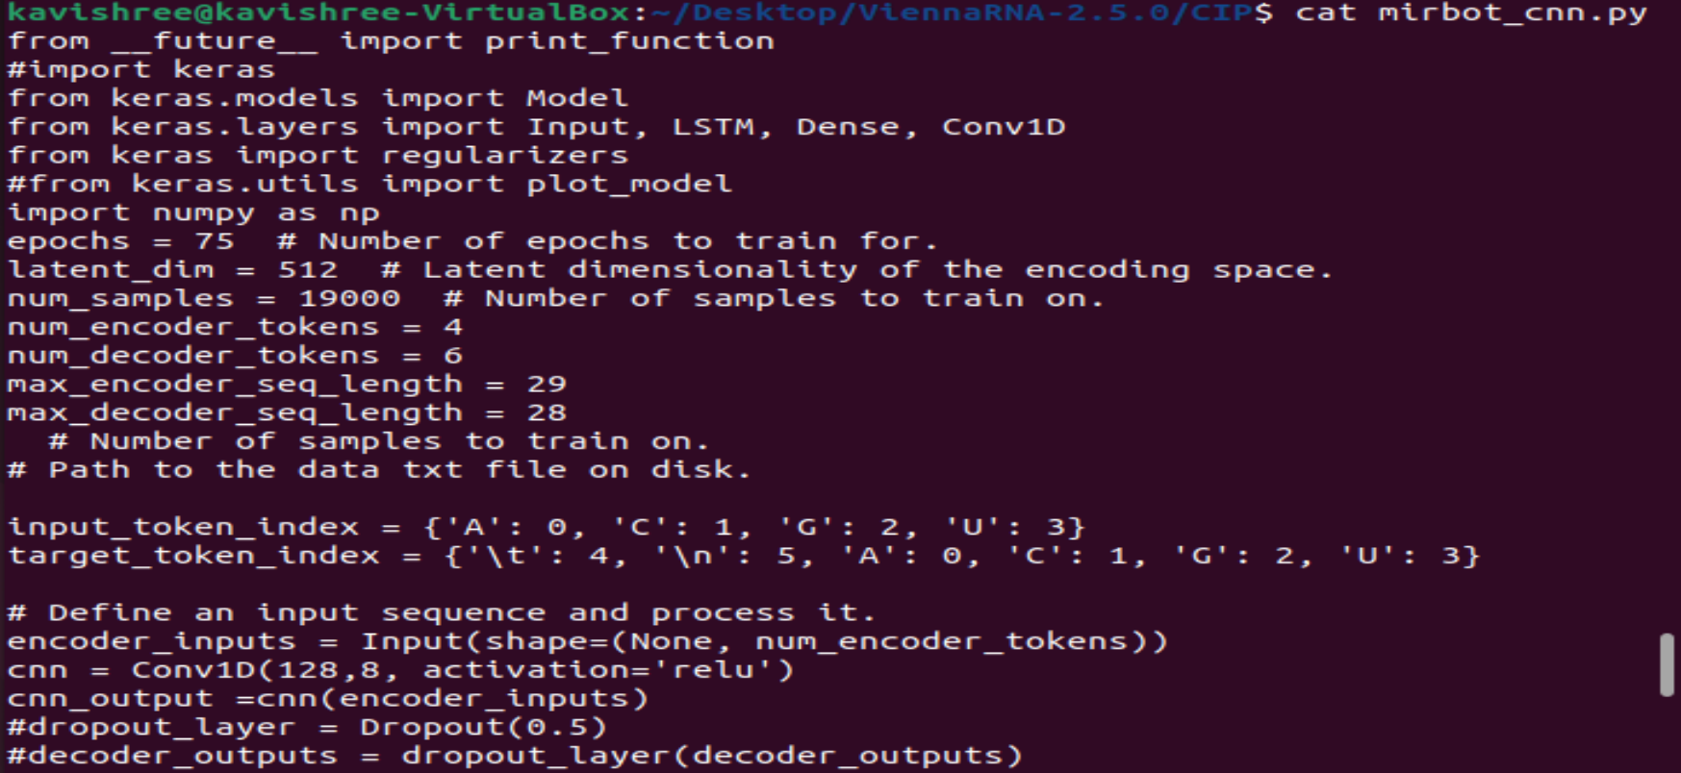
Implementation
Mirbot_cnn.py

Slide 24
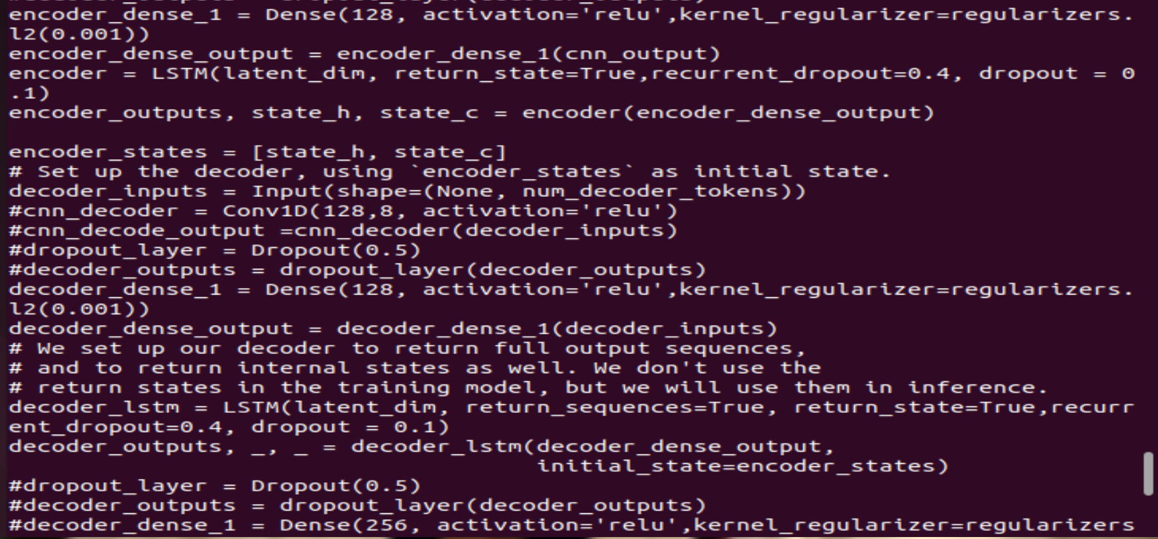

Slide 25
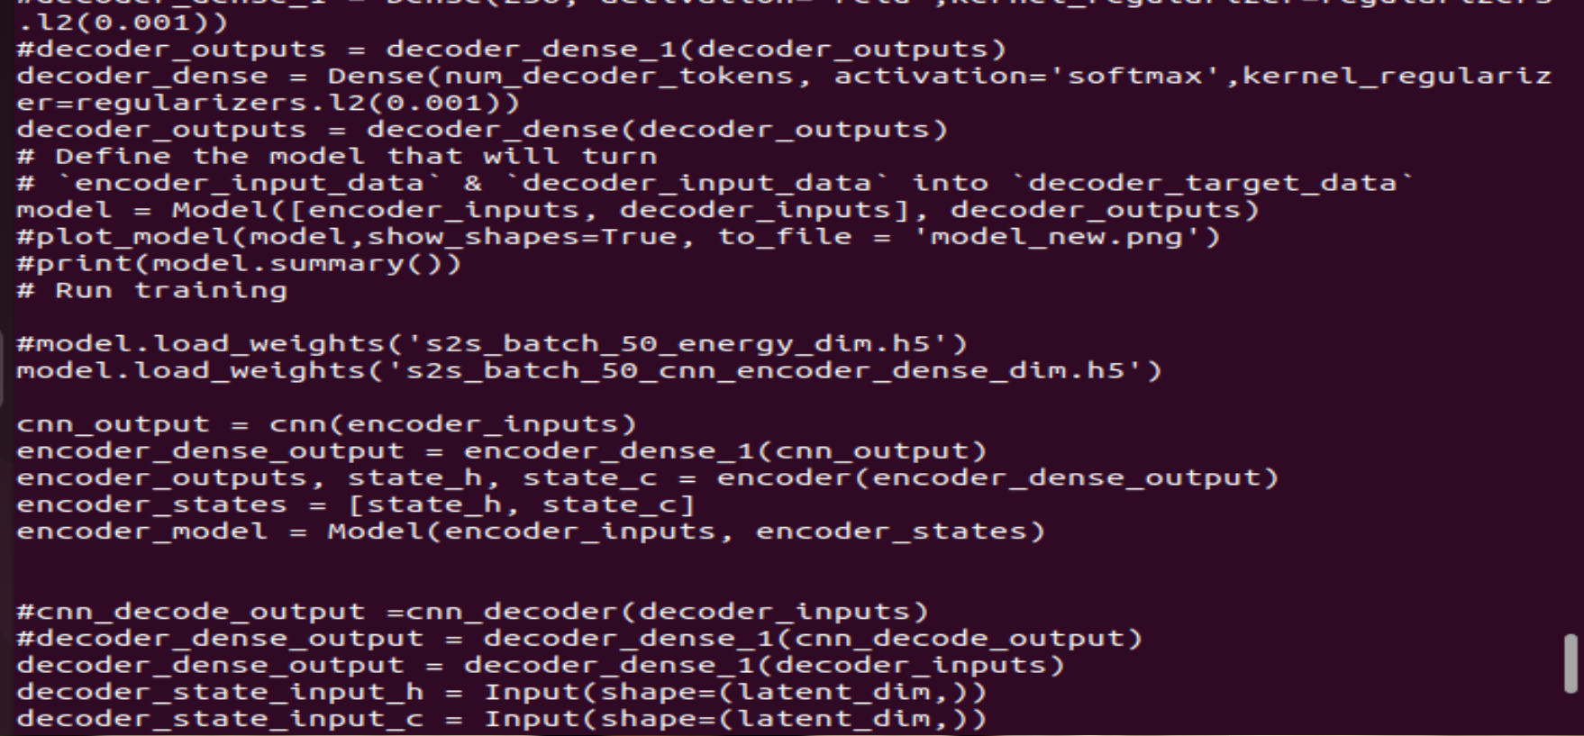

Slide 26
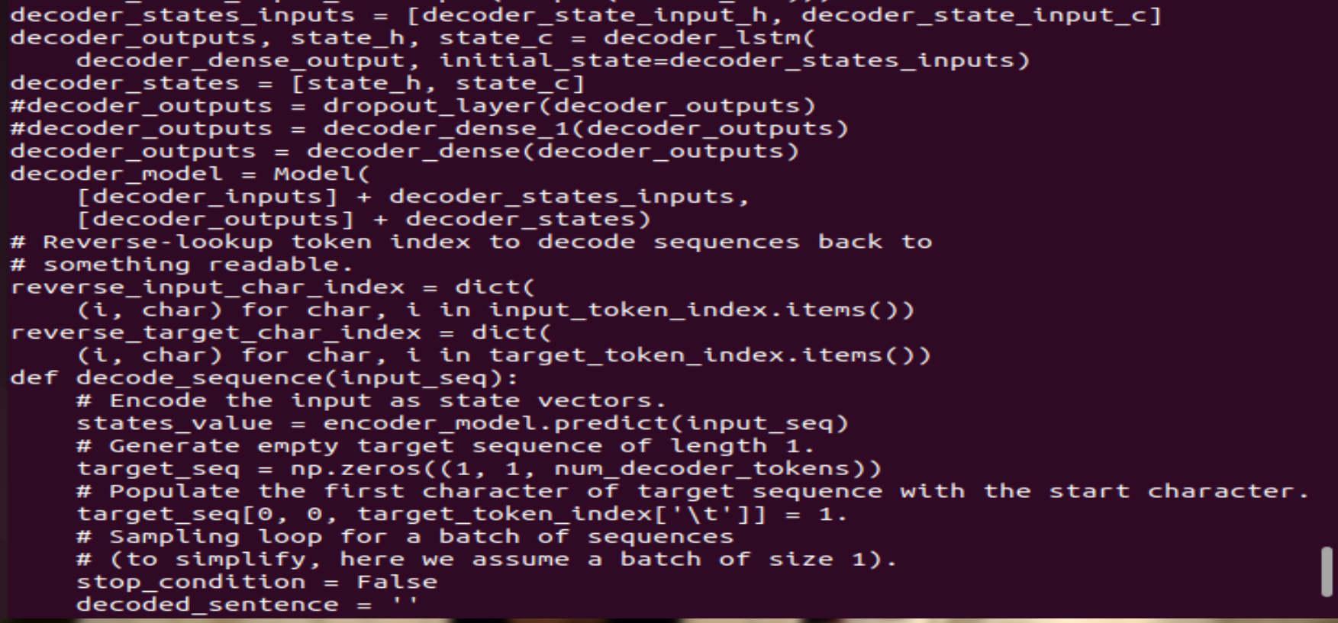

Slide 27
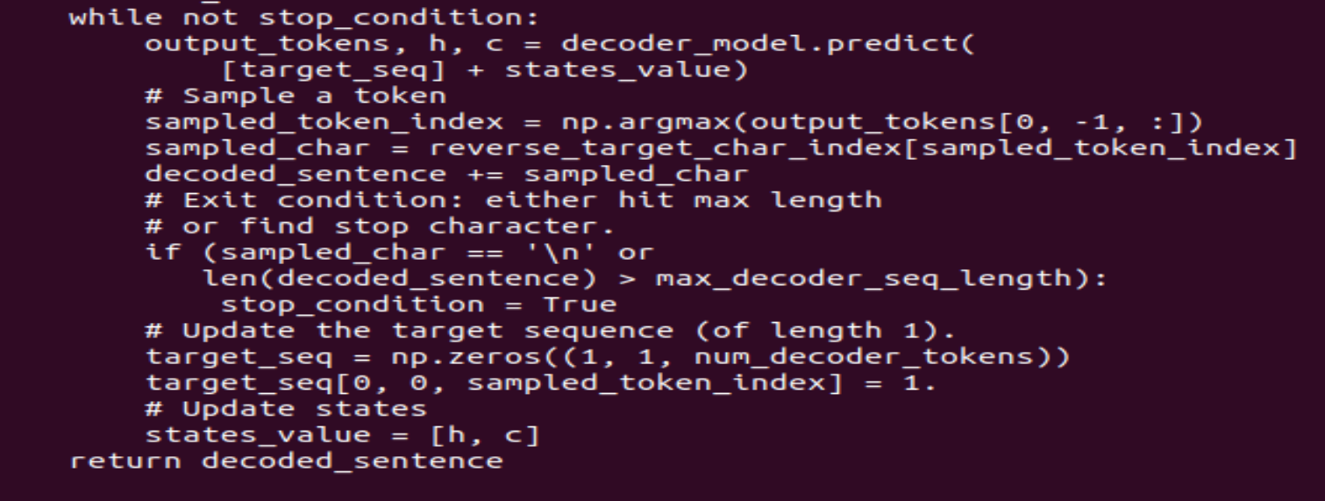
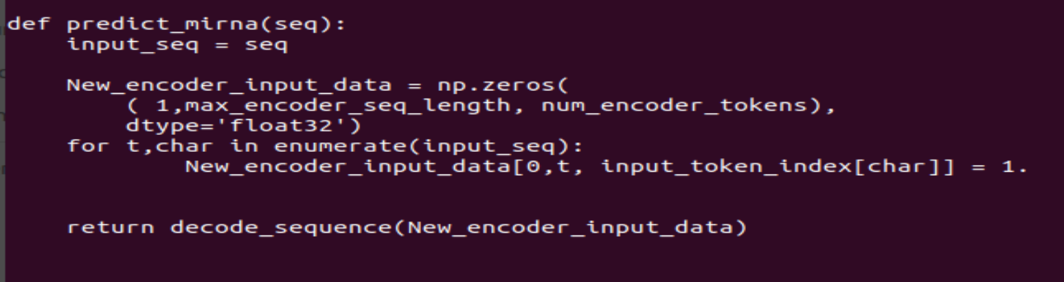

Slide 28
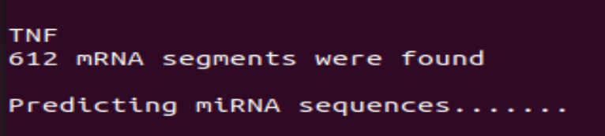
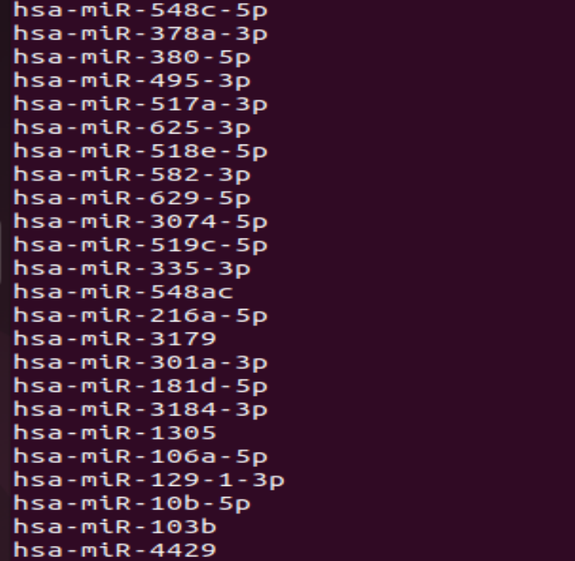
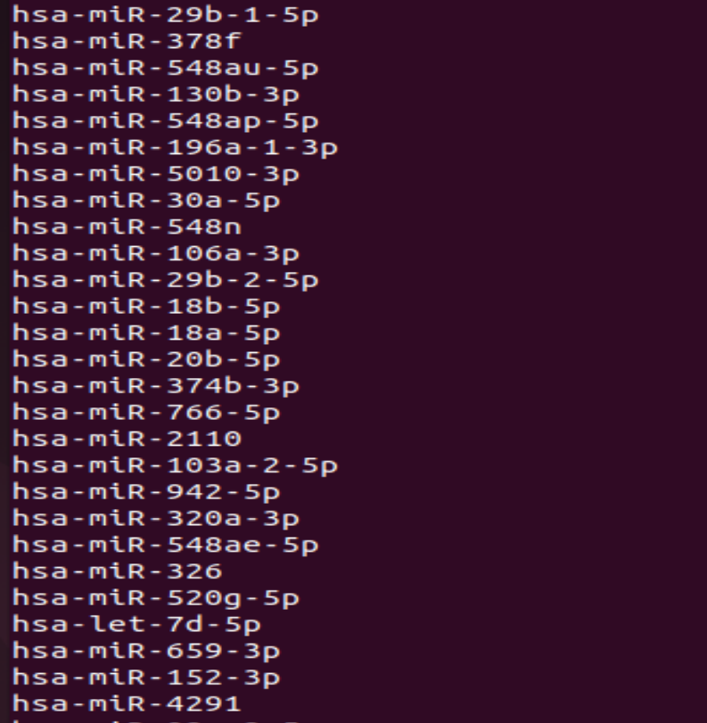
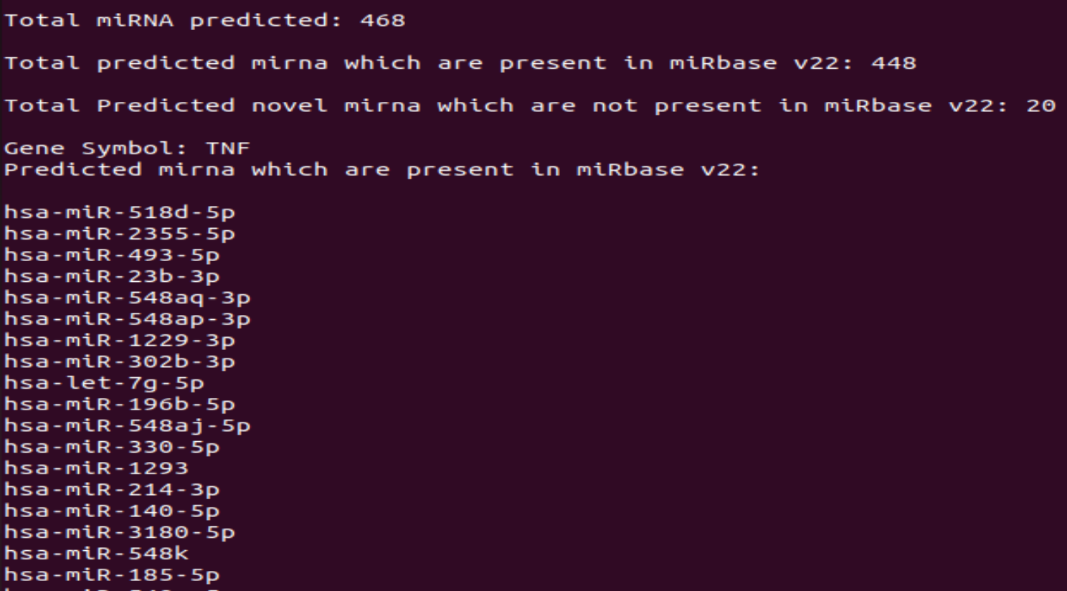
OUTPUT

Slide 29
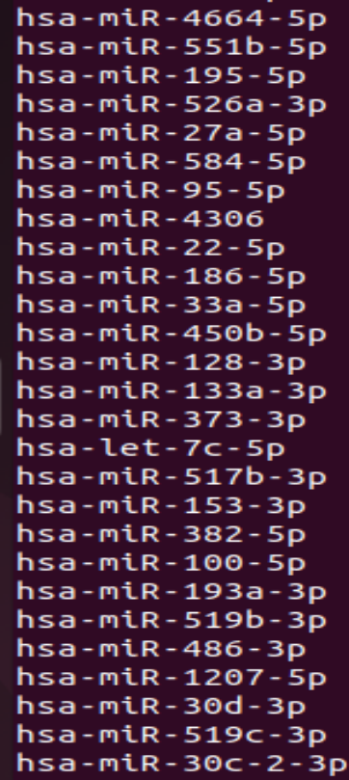
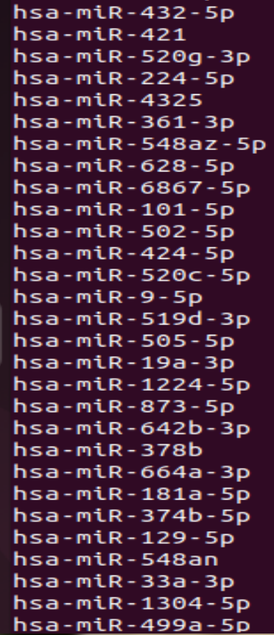
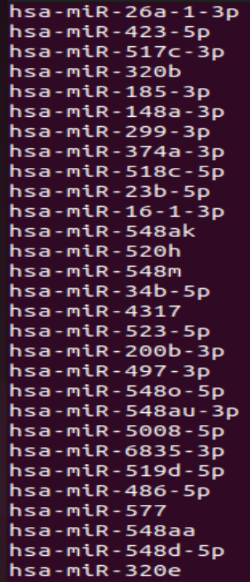

Slide 30
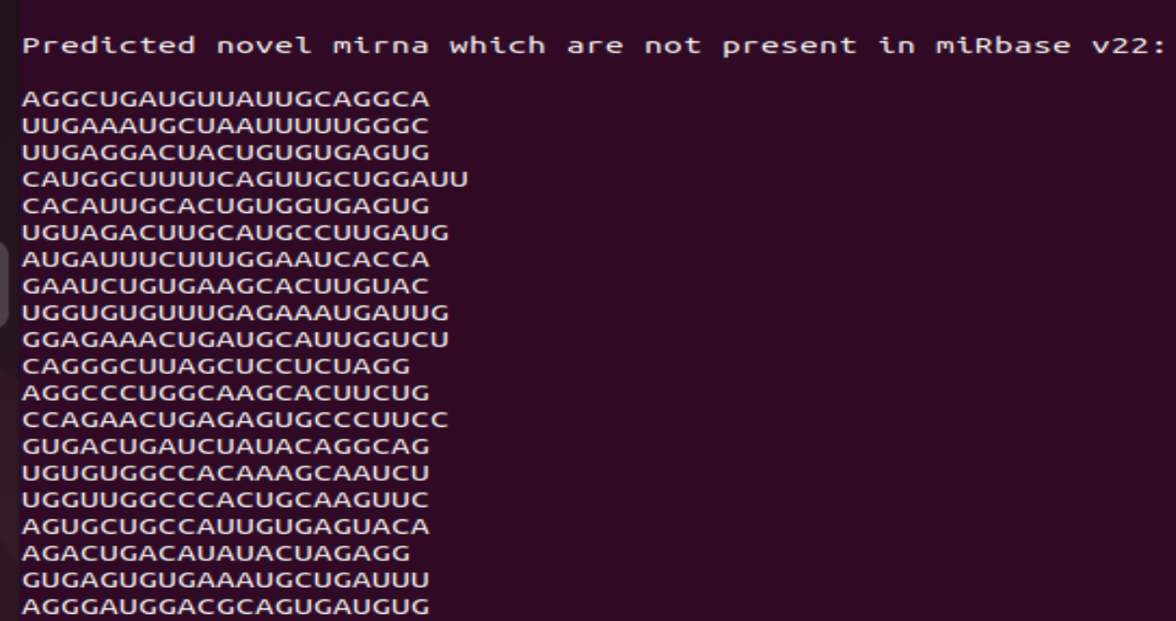

Slide 31
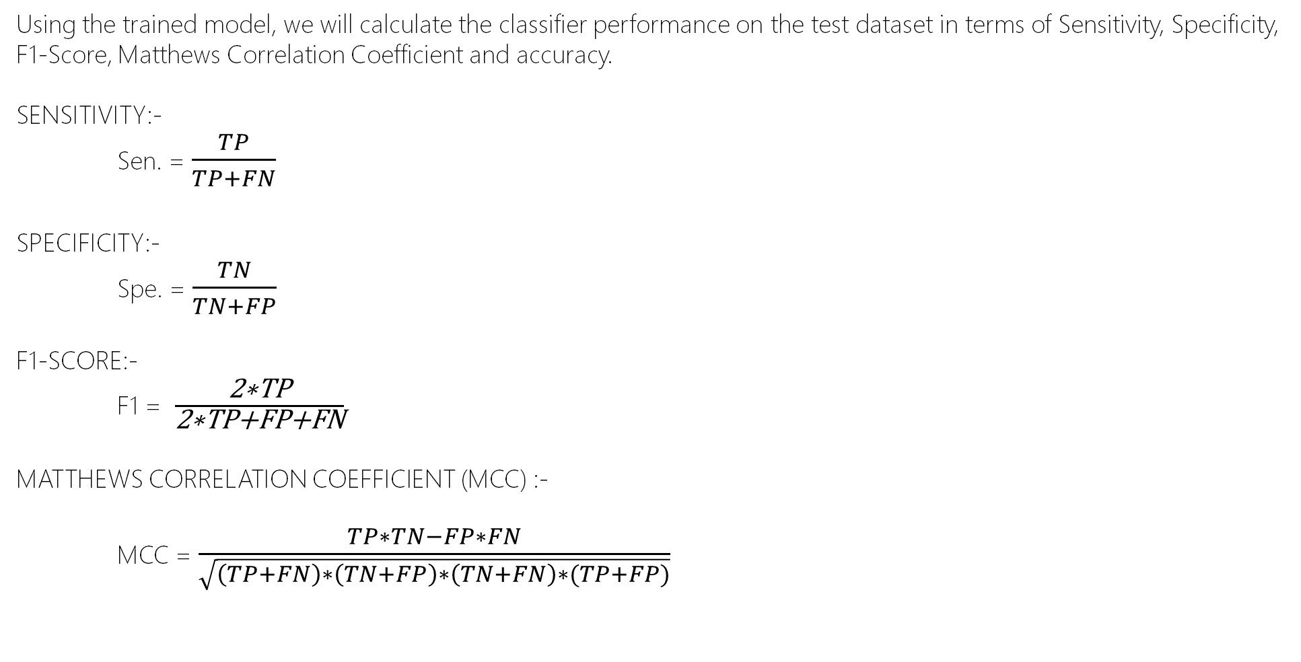
Evaluation Metrics
Using the trained model, we will calculate the classifier performance on the test dataset in terms of Sensitivity, Specificity, F1-Score, Matthews Correlation Coefficient and accuracy.
SENSITIVITY:-
Sen. = $\frac{TP}{TP+FN}$
SPECIFICITY:-
Spe. = $\frac{TN}{TN+FP}$
F1-SCORE:-
F1 = $\frac{\text{2∗}\text{TP}}{\text{2∗}\text{TP}\text{+}\text{FP}\text{+}\text{FN}}$
MATTHEWS CORRELATION COEFFICIENT (MCC) :-
MCC = $\frac{TP∗TN−FP∗FN}{\sqrt{\left(TP+FN\right)∗\left(TN+FP\right)∗\left(TN+FN\right)∗(TP+FP)}}$

Slide 32
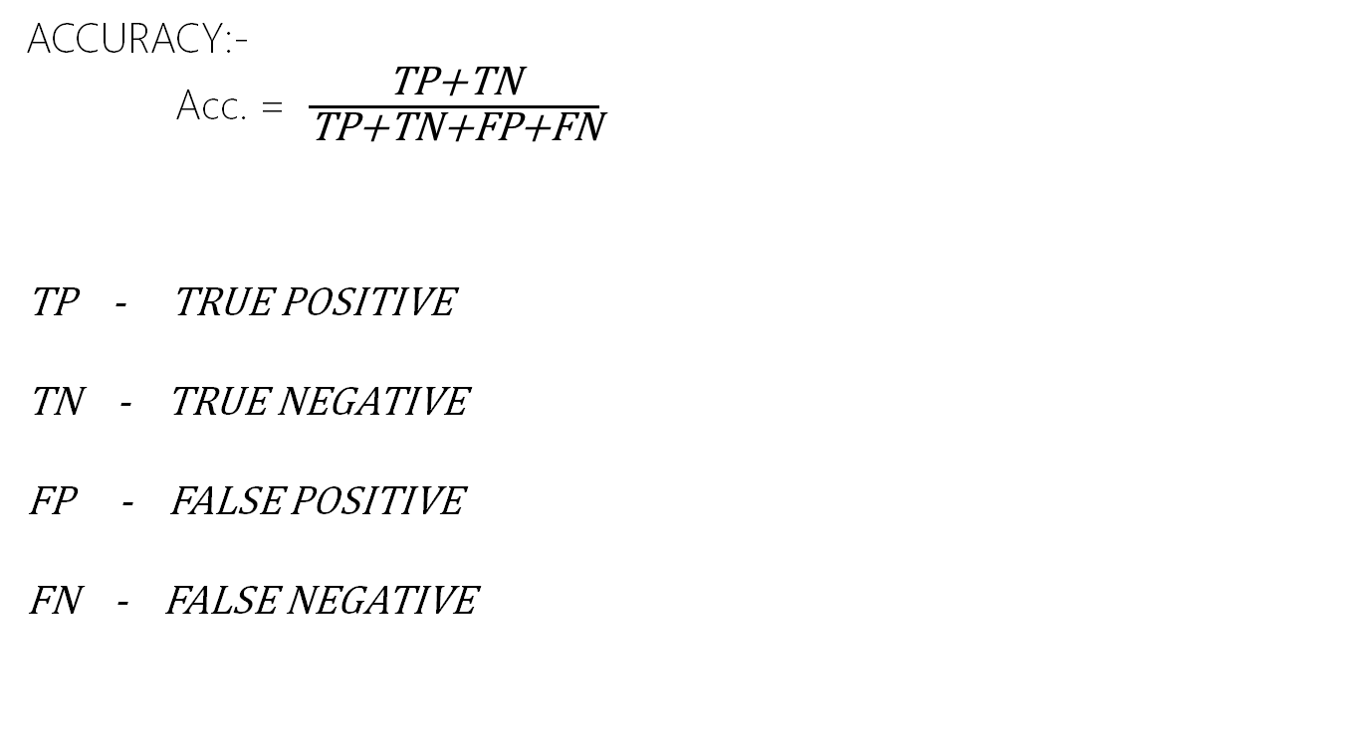
Evaluation Metrics
ACCURACY:-
Acc. = $\frac{\text{TP}\text{+}\text{TN}}{\text{TP}\text{+}\text{TN}\text{+}\text{FP}\text{+}\text{FN}}$
TP - TRUE POSITIVE
TN - TRUE NEGATIVE
FP - FALSE POSITIVE
FN - FALSE NEGATIVE

Slide 33
Project analysis slide 10
References
Alipanahi B, Delong A, Weirauch MT, Frey BJ (2015) Predicting the sequence specificities of DNA- and RNA-binding proteins by deep learning. Nat Biotechnol 33: 831–838. https://doi.org/10.1038/nbt.3300 PMID: 26213851
Dueck A, Ziegler C, Eichner A, Berezikov E, Meister G (2012) microRNAs associated with the different human Argonaute proteins. Nucleic Acids
Res 40: 9850–9862. https://doi.org/10.1093/nar/gks705 PMID: 22844086
Winter J, Jung S, Keller S, Gregory RI, Diederichs S (2009) Many roads to maturity: microRNA biogenesis pathways and their regulation. Nat Cell Biol 11: 228–234. https://doi.org/10.1038/ncb0309-228 PMID: 19255566
Kozomara A, Griffiths-Jones S (2014) miRBase: annotating high confidence microRNAs using deep sequencing data. Nucleic Acids Res 42: D68–73. https://doi.org/10.1093/nar/gkt1181 PMID: 24275495
Mandujano-Tinoco EA, Garcia-Venzor A, Melendez-Zajgla J, Maldonado V (2018) New emerging roles of microRNAs in breast cancer. Breast Cancer Res Treat.
Brennecke J, Stark A, Russell RB, Cohen SM (2005) Principles of microRNA-target recognition. PLoS Biol 3: e85. https://doi.org/10.1371/journal.pbio.0030085 PMID: 15723116
Grimson A, Farh KK, Johnston WK, Garrett-Engele P, Lim LP, et al. (2007) MicroRNA targeting specificity in mammals: determinants beyond seed pairing. Mol Cell 27: 91–105. https://doi.org/10.1016/j. molcel.2007.06.017 PMID: 17612493
Chen W, Zhao W, Yang A, Xu A, Wang H, et al. (2017) Integrated analysis of microRNA and gene expression profiles reveals a functional regulatory module associated with liver fibrosis. Gene 636: 87– 95. https://doi.org/10.1016/j.gene.2017.09.027 PMID: 28919164

Slide 34
Project analysis slide 10
References
Wen M, Cong P, Zhang Z, Lu H, Li T (2018) DeepMirTar: a deep-learning approach for predicting human miRNA targets. Bioinformatics 34: 3781–3787. https://doi.org/10.1093/bioinformatics/bty424 PMID: 29868708
Pla A, Zhong X, Rayner S (2018) miRAW: A deep learning-based approach to predict microRNA targets by analyzing whole microRNA transcripts. PLoS Comput Biol 14: e1006185. https://doi.org/10.1371/ journal.pcbi.1006185 PMID: 30005074
Xu A, Chen J, Peng H, Han G, Cai H (2019) Simultaneous Interrogation of Cancer Omics to Identify Subtypes With Significant Clinical Differences. Front Genet 10: 236. https://doi.org/10.3389/fgene. 2019.00236 PMID: 30984238
Shen D, Wu G, Suk HI (2017) Deep Learning in Medical Image Analysis. Annu Rev Biomed Eng 19: 221–248.
https://doi.org/10.1146/annurev-bioeng-071516-044442 PMID: 28301734
Helwak A, Kudla G, Dudnakova T, Tollervey D (2013) Mapping the human miRNA interactome by CLASH reveals frequent noncanonical binding. Cell 153: 654–665. https://doi.org/10.1016/j.cell.2013. 03.043 PMID: 23622248

Slide 35
Thank You

